Slide 1

Data analytics approach

Slide 2
table of contents
01
02
03
04
Introduction
Data Exploration & Interpretation
Model Development
Conclusion

Slide 3

about the project
Sprocket Central Pty Ltd Deals in high-quality bikes and accessible cycling accessories to riders
Marketing team wants to improve performance by focusing on high value customers
We have analysed the data and found compelling results

Slide 4
-01-
Introduction

Slide 5
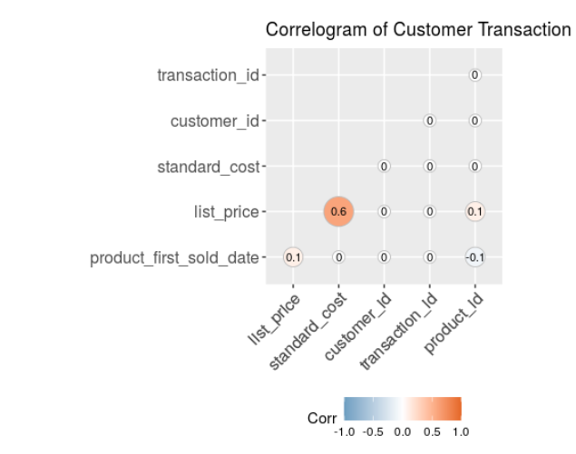
Introduction
Sprocket Central wants to focus on the new high value customers based on transaction, customer demographic and address data
It is forecasted that bike sale will be $64,000/month
Females are more prone to buy biikes
Approx 54% of business is focused in New South Wales

Slide 6
-02-
Data Exploration & Interpretation

Slide 7
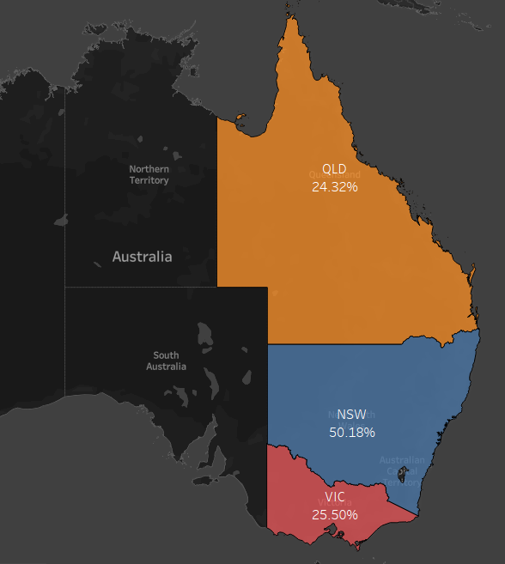
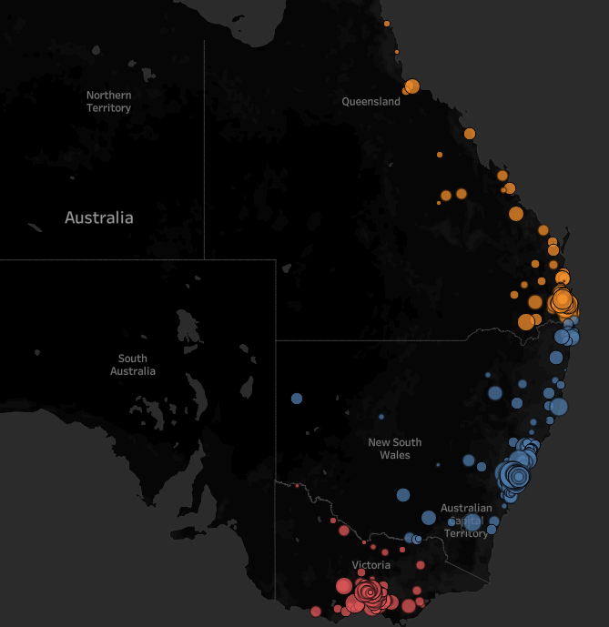
this is a map
It shows that most of the probable customers are distributed along the coastal area and that in New South Wales

Slide 8
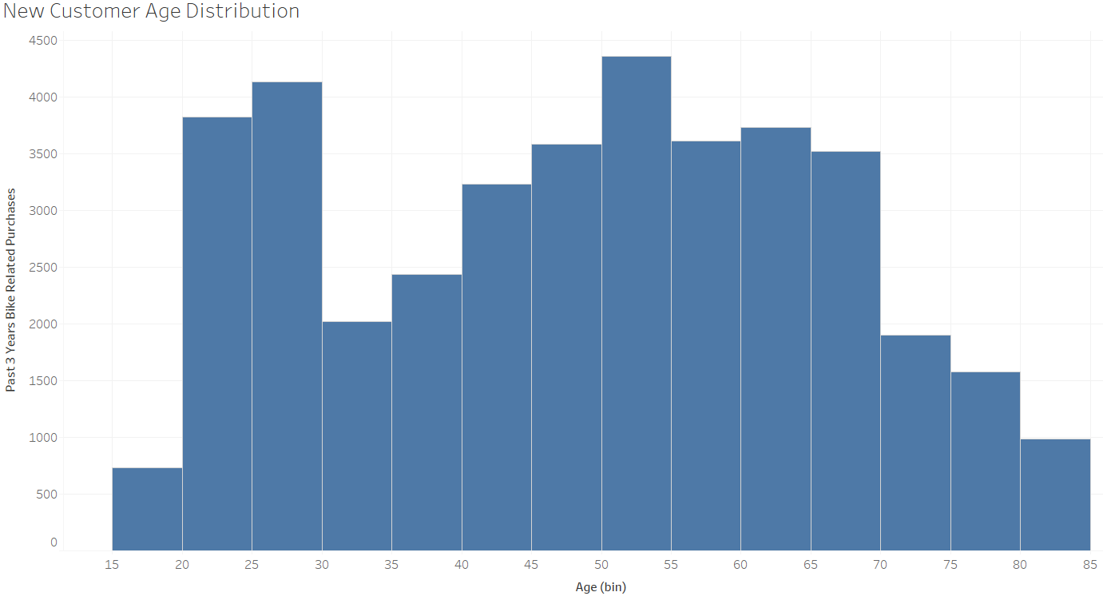
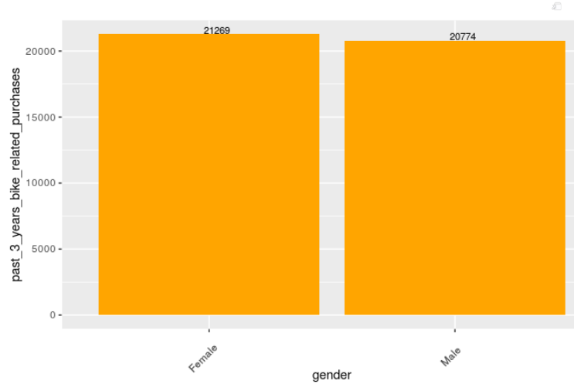
Age and Gender Distribution
Most of the customers are distributed between 20-30 and 50-55 of age
Of all the customers, female has more bike related purchase in last 3 years

Slide 9
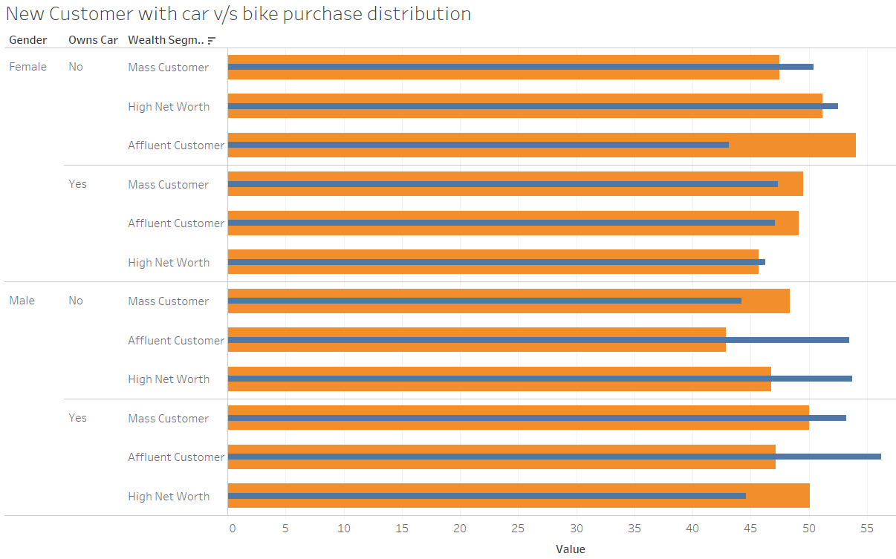
Bike Purchase wrt Age, Gender and Wealth Segment
It is also noticeable that Mass Customer Segment in both Female And Male gender are possible high valued customers
Also these Mass Customers are having average age of 45-55
It is also observed that customer who owns car have more bike related purchases

Slide 10
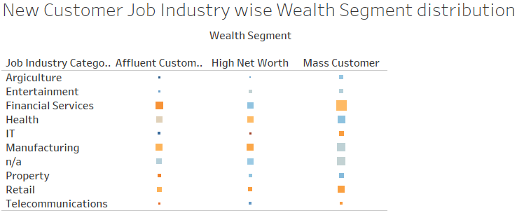
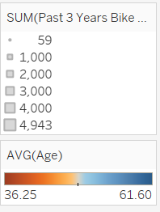
Bike Purchase wrt Age, job Category and Wealth Segment
Mass Customers with background from Financial Services and Manufacturing should be focused more as they had more bike related purchases
Also their average age is between 40-50

Slide 11
-03-
Model Development

Slide 12
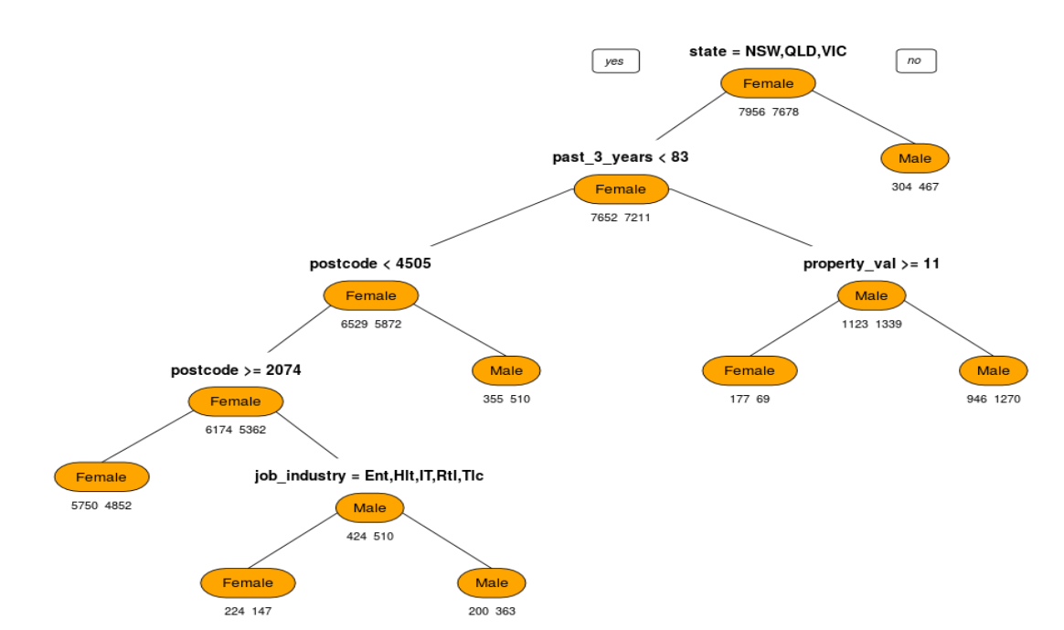
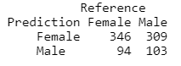
Decision Tree
Model has also predicted category of high valued genders based on train data
Implemented this model to find the pattern based on gender, job industry and State for bike purchase for last 3 years

Slide 13
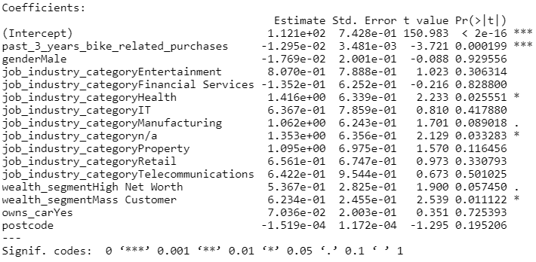
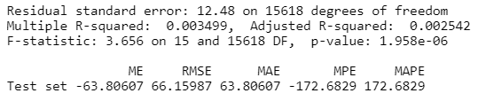
Multivariate Linear Regression
Results shows the low R square but good P-value
It shows that what all are the critical indicators for identifying high valued customers
One with 3 stars is the critical parameter which can influence our end result

Slide 14
-04-
Conclusion

Slide 15
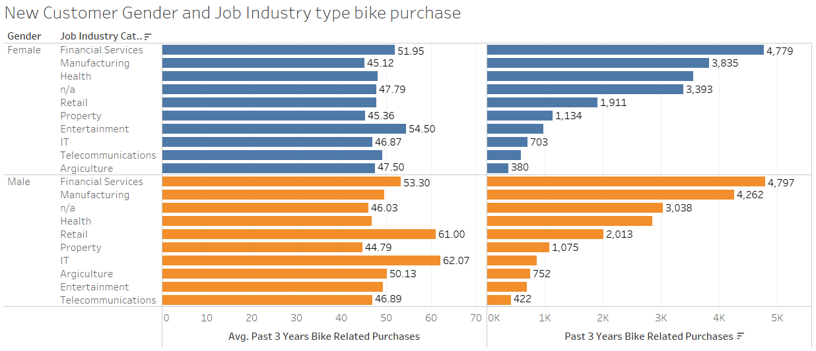
Bike Purchase wrt Gender and job Category
Female customers with background from Financial Services and Manufacturing should be focused more as they had more bike related purchases
Also Average bike purchase is highest for entertainment industry which can be taken into consideration
Past 3 years bike related purchase is the critical parameter for identifying valued customers

Slide 16
Thanks

